Slide 1

User manual

Slide 2
Presentation

Slide 3
A quiet virtual pet
2 mini games
7 food types
Friends visits and presents
Single-button action
No sound
No death
Runs on Arduino Leonardo R3
Available for Arduboy and M5 Stick C+

Slide 4
A quiet virtual pet
TiMiNoo ("Tee Me Noo") is a virtual cat providing minimal distraction, fully office-compatible, single button action, no sound, no death. The cat is different on each run, his characteristics are randomly picked at startup. It has been created with busy people in mind: The gameplay is simple enough for this game to be enjoyed in a work environment.
TiMiNoo is a feature-rich virtual cat, a companion for busy days: Cuddle, Feed, Educate, Wash and Entertain your very own furry companion. Tamagotchi lovers could compare it to a Nano.

Slide 5
Features

Slide 6
Single button gameplay
Wanting a gameplay as simple as can be, a single button solution seemed very appealing. Click once or click repeatedly depending on the action, that's it.

Slide 7
No sound
Having a virtual pet on my desk at work is lovely, but I need to preserve my workflow from distractions. No beeping sounds is what I want.

Slide 8
2 mini games
Catsino Deluxe: Go to the casino with your TiMiNoo and do your best to win some yummy food to bring home. Beware of the ghost though!
Catwash Station: When the fur of your TiMiNoo gets dirty, it's time for a proper toilet. Scrub scrub!

Slide 9
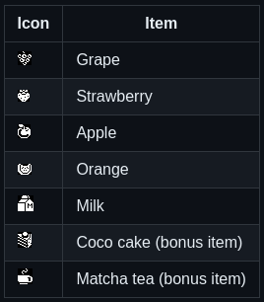
7 food items
Feed your TiMiNoo whenever he gets hungry. TiMiNoo doesn't die if you don't feed him, but he will give you that big eyes stare. Feed him a variety of food including:

Slide 10
Lessons with Professor Koko
Your TiMiNoo wants to become a cultured cat. Call Professor Koko Le Snail, a wise teacher that will share his best knowledge with him.

Slide 11
Cuddle time
TiMiNoo craves attention and love, make sure to give him plenty.

Slide 12
Visits from a friend
Occasionally, when TiMiNoo gets hungry, his friend comes home and offer either a cup of hot Matcha tea or a slice of home made Coco cake.

Slide 13
Gain points: scoring system
Earn points every time you take action and increase your score.

Slide 14
How to play

Slide 15
Build your own

